Slide 1

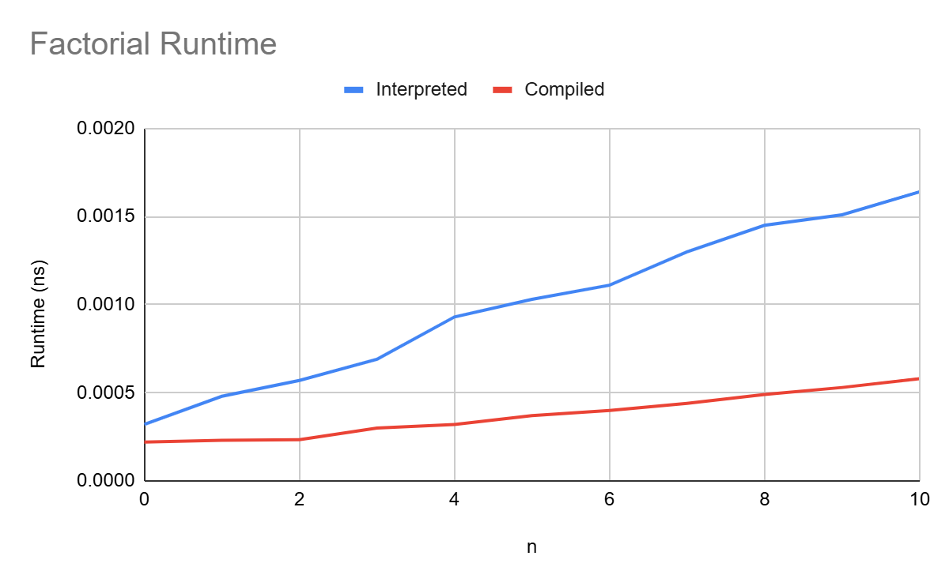
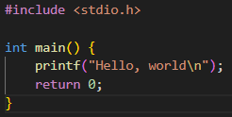
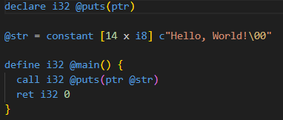
Implementing a Toy Compiler
Andrew DeSimone, Brian Toone
Mathematics and Computer Science
Central Research Question
What are the key challenges in language design and compiler development?
Can the performance differences between compiled and interpreted languages be quantified
Planned Implementation
Define Language Grammar
Write a Lexer by Hand
Write a Parser using Recursive Descent
Generate LLVM IR
Problems
Frequent issues with language definition
Handwritten lexers/parsers lacked flexibility
Generators enabled easier language definition experimentation
LLVM toolkit was unstable on Windows
Actual Implementation
Define Language Grammar
Generate Lexer using Flex
Generate Parser using Bison
Modify Grammar
Generate C IR
Minimum Viable Product
Supports fundamental arithmetic operations
Handles 32-bit integer variables
Capable of outputting results
Restricted to basic operations
Limited compared to other toy languages
Functions as a proof of concept
Language Definition
Lexical Grammar:
number = [0-9]+
asterik = "*"
plus = "+"
semicolon = ";"
Sentence Grammar:
<program> := <vars> <stmts> semicolon
<vars> := number
<stmts> := <multstmts> <addstmts>
<multstmts> := {asterik number}*
<addstmts> := {plus number}*
Compilation Steps
Performance Methodology
Compare Interpreted vs. Compiled Languages
Python as the interpreted language
Unoptimized C as a proxy for toy language
Factorial for Benchmarking
Results
Conclusion
In terms of raw performance the compiled code significantly outperformed interpreted code. However this is not without drawbacks, in large scale programs compilation times become a concern. Furthermore, interpreted languages can save you significant development time.
“3*4+2;”
Background
How machines think:
Follow instruction precisely
Instructions must be unambiguous
Instructions must be in the machine’s native language
How humans think:
Think abstractly and contextually
High tolerance for error or ambiguity
Fill in gaps based on intuition and prior knowledge
Programming languages:
Bridge the gap between human and machine thinking
Human-readable syntax for easier understanding
Well-defined instructions that can be translated into machine code
Human program:
I want the machine to say “Hello, world”
Computer program:
Machine instructions:
Compiler:
Translates human-readable code into machine code
Operates in multiple passes:
Lexing pass (words and punctuation)
Parsing pass (sentences)
Intermediate representation
Optimization
Code generation (instructions)
.
<N, 3>,<*>,<N, 4>,<+>,<N, 2>,<;>
Program
Vars Stmts
MultStmts AddStmts
3 4 2
References
[1] Keith Cooper and Linda Torczon. Engineering a Compiler.
[2] About — LLVM 21.0.0git documentation. Retrieved April 9, 2025 from https://llvm.org/docs/
[3] Crafting Interpreters. Retrieved April 9, 2025 from https://craftinginterpreters.com/
[4] GCC online documentation - GNU Project. Retrieved April 9, 2025 from https://gcc.gnu.org/onlinedocs/
[5] GNU Bison - The Yacc-compatible Parser Generator - GNU Project - Free Software Foundation. Retrieved April 9, 2025 from https://www.gnu.org/software/bison/manual/
[6] Lexical Analysis With Flex, for Flex 2.6.2: Top. Retrieved April 9, 2025 from https://westes.github.io/flex/manual/
[7] LLVM Hello World | Dr James Hamilton. Retrieved April 9, 2025 from https://jameshamilton.eu/programming/llvm-hello-world
Store A, 3
Mult A, 4
Add A, 2
Print A
.

